Slide 1
Chapter 8
Perfectly competitive markets

Slide 2
Markets can be divided to four markets based on number of firms, type of products and ease to entry.
Market structure | Number of firms | Type of products | Ease to entry | Examples
Perfect competition | many | Identical | high | Wheat apple
Monopolistic competition | Many | differentiated | high | restaurants
Oligopoly | few | Identical or differentiated | low | Computers cars
monopoly | one | unique | Entry blocked | water

Slide 3
Perfect competition markets
A perfectly competitive market meets the conditions of
1. There are many number of buyers and sellers
2. all firms sell identical products
4. no barriers to new firms entering the market (entry into the market is free).
4. in perfectly competitive markets, Firms can not affect the prices of the goods and services.
5. Firms cannot earn economic profits in the long run.
For example, agricultural products.

Slide 4
Firms cannot affect the market price
in perfect competition markets, Price is determined by the interaction between demand and supply.
Buyers and sellers can not affect the market price.
Consumers and firms have to accept the market price. Thus, Consumers and firms are price takers.
Price taker: Consumers and firms are unable to affect the market price.

Slide 5
In perfect competition market, the price is determined by the market
Market equilibrium exists, when quantity demanded equals quantity supplied.
price D S
4
20,000 quantity
Market of oranges
The price of orange is 4 pounds and the quantity of equilibrium is 20,000.

Slide 6
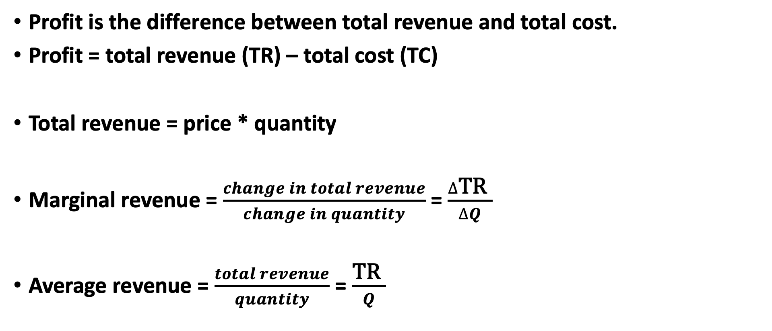
Revenue of the firm in perfect competition market
Profit is the difference between total revenue and total cost.
Profit = total revenue (TR) – total cost (TC)
Total revenue = price * quantity
Marginal revenue = $\frac{change in total revenue}{change in quantity}$ = $\frac{∆\text{TR} }{∆Q}$
Average revenue = $\frac{total revenue}{quantity}$ = $\frac{\text{TR} }{Q}$

Slide 7
Total revenue, average revenue and marginal revenue
NUMBER OF Kilos (Q) | Market Price | Total Revenue | Marginal Revenue | Average Revenue
1 | 4 | 4 | 4 | 4
2 | 4 | 8 | 4 | 4
3 | 4 | 12 | 4 | 4
4 | 4 | 16 | 4 | 4
5 | 4 | 20 | 4 | 4
6 | 4 | 24 | 4 | 4
7 | 4 | 28 | 4 | 4

Slide 8
Relation between price, marginal revenue and average revenue
revenue
MR = AR = Price
quantity
Price is equal to both average revenue and marginal revenue.

Slide 9
Profit-maximizing level of output
firms maximize profit at the level of output, where marginal revenue equals marginal cost.
The profit maximizing level of output is, where marginal revenue equals marginal cost (MR = MC).

Slide 10
Profit maximization The firm maximizes profit at the level of output (100), where marginal revenue equals marginal cost (MR=MC).
MC
AC
10 MR = AR
output 100
The intersection between marginal revenue and marginal cost determines the equilibrium point for the firm.

Slide 11
Profit per unit = average revenue – average cost
MC
ATC
10 MR = AR
7
output 100
Profit per unit = AR – AC = 10 – 7 = 3
total profit = Q * 3 = 100 * 3 = 300

Slide 12
could you estimate the profit? the quantity of equilibrium = 60 units, where (MR=MC). Profit per unit = AR – AC = 20 - 10 = 10. Total profit = 60 x 10 = 600 dollars. Firms achieve economic profit because average revenue is higher than average cost
MC
AC
20 a MR=AR
10 b
output 60

Slide 13
firm maximizes profit at 40 units, MR = MC. Profit per unit = AR – AC = Zero firm is at break- even point
MC
AC
8 MR=AR
40 output
break- even point

Slide 14
The quantity of equilibrium is 30 units, where MR = MC. Profit per unit = AR – AC = 5 – 8 = -3 firm makes loss
MC
AC
loss MR=AR = price
5
30 output
8

Slide 15
There are three possibilities:
Firm makes profit if average revenue is higher than the average cost.
Firm is at break even point if average revenue equals average cost.
Firm makes loss if average revenue is less than the average cost.

Slide 16
The supply curve of a firm in the short run
The firm will produce the level of output, where MR = MC
In perfect competition market, P = MR
The firm will produce , where P = MC
For any given price, we can determine from marginal cost the output produced by the firm (the firm supply curve).
Therefore, the marginal cost curve is the supply curve.
From the next figure, the marginal cost is the supply curve for price equals or above average variable cost (AVC)

Slide 17
Shut down in the short run The shutdown point : is the minimum point on the average variable cost. If the price falls below this point, the firm will shut down production.
MC
ATC
AVC
5
output

Slide 18
The marginal cost intersects the average variable cost, where the average variable cost at the minimum point.
Therefore, the firm’s supply curve is the marginal cost curve above the minimum point of the average variable cost.
The minimum point on the average variable cost is called the shutdown point.
If the price falls below this point, the firm will shut down production.

Slide 19
Supply curve
MC of the firm
Market supply curve
price
price
MC
supply curve
$ 4
$ 4
8,000
1,800,000,0000
Quantity (kilos)
Quantity (kilos)

Slide 20
The equilibrium in the short run
Market equilibrium
It exists at the intersection between demand and supply ( at point A).
Demand = supply
The price of equilibrium is 15
The quantity of equilibrium is 30,000 kilos.
Firm equilibrium
The firm produces at the level of product , where MR = MC (point B)
the quantity of equilibrium = 100
The price is the market price = 15
Profit per unit is = AR – AC = 15 – 12 = 3 pounds
total profit = Q * 5 = 100*3= 300
There is economic profit in the short run

Slide 21
Equilibrium in the short run
Market equilibrium
Firm equilibrium
price
price
MC
demand
supply
ATC
A
P=AR=MR
15
15
B
12
quantity
30,000
quantity
100

Slide 22
Long run equilibrium in perfect competition market
The economic profit attracts new firms to enter the market.
The entry of new firms shifts the supply curve to right.
The market price will decrease until the firm is breaking even (profit =0).
This process (the entry or exit of firms) results in long run equilibrium.
In Long run, price equals the minimum point on the average total cost (10 pounds).

Slide 23
Equilibrium in the LONG RUN
Market equilibrium
Firm equilibrium
price
price
MC
demand
S1
ATC
S2
A
P=AR=MR
15
15
B
10
10
C
D
quantity
30,000
40,000
quantity
100

Slide 24
In the long run
The intersection between the demand and supply determines the price and the quantity of equilibrium.
In Long run, market price equals the minimum point on average cost
In the long run, Firm equilibrium point is at point D because MR = MC
In the long run, Market equilibrium is at point C, where S2 = demand
Profit = AR – AC = 10 – 10 = 0
the profit is zero in the long run

Slide 25
Equilibrium in the long run
Market equilibrium
Firm equilibrium
price
price
MC
demand
supply
ATC
A
P=AR=MR
10
10
B
quantity
30,000
quantity
80

